Slide 1
5 Minute Objective-C Primer
Joe Ibanez
@jose_ibanez

Slide 2

About Me
Foursquare Mayor & Mobile Developer at Empathy Lab
VB.NET developer for 6 years
iOS development part time ~ 2 years

Slide 3
Person Class
Read Only name
Read Only Social Security Number
Constructor that initializes both

Slide 4
Java
public class Person {
private String name;
private int ssn;
public Person(String name, int ssn) {
this.name = name;
this.ssn = ssn;
}
public getName {
return this.name;
}
public getSSN {
return this.ssn;
}
}
…
Person dudeFella = new Person(“Mr. Dude”, 111223333);

Slide 5
Person.h
@interface Person : NSObject
@property (strong, readonly) NSString *name;
@property (readonly) NSInteger ssn;
- (id)initWithName:(NSString *)name ssn:(NSInteger)ssn;
@end

Slide 6
Person.m
#import Person.h
@implementation Person
@synthesize name = _name;
@synthesize ssn = _ssn;
- (id)initWithName:(NSString *)name ssn:(NSInteger)ssn {
self = [super init];
if (self) {
_name = name;
_ssn = ssn;
}
return self;
}
@end

Slide 7
Person Usage
Person *dudeFella = [[Person alloc] initWithName:@”Mr. Dude”
ssn:111223333];

Slide 8
What the Hell is Objective-C!?

Slide 9
History
Forked off of C around the same time as C++
Adds Objects
Adds “Smalltalk-style” messaging
C
C++
C#
Java
Obj-C
Everything Else You’ve Ever Heard of

Slide 10
Lots of similarities…
Strict superset of C
Lines end with a semicolon
Ignores whitespace
Must declare strongly typed variables
If, for, while statements

Slide 11
Obj-C Objects
Single Inheritance
Implement multiple protocols (templates/interfaces)
No Abstract/Virtual Classes
@interface ClassName : ParentClass <Protocol1, Protocol2> {
/* instance variables */
}
/* properties and methods defined here */
@end
@implementation ClassName
…
@end

Slide 12
Defining Obj-C Methods
- (id)initWithName:(NSString *)name ssn:(NSInteger)ssn;
Target – instance of class Person
Return Type – id
Method Signature – initWithName:ssn:
Arguments – NSString, NSInteger
Cannot overload messages!

Slide 13
Obj-C Messages
dudeFella.getName();
Direct call to a function at an address
[dudeFella name];
Encapsulates all the info needed to call correct method
Target
Method signature
Arguments
Return Type
A message is an object!

Slide 14
Obj-C Messages: Why?
Dynamically respond to messages at runtime
Can pass messages to nil
Add functionality to existing classes without subclassing with categories

Slide 15

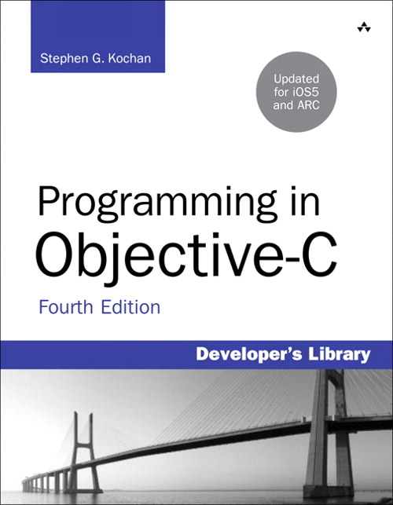
Further Reading
Objective-C Programming:
The Big Nerd Ranch Guide
Programming in Objective-C (4th Ed)
Stephen G. Kochan
Aaron Hillegass

Slide 16
Further Reading
Stanford iPad and iPhone App Development

Slide 17
C#
Class Person
{
private String name;
public String Name
{
Get { return name; }
}
private int ssn;
public int SSN;
{
Get { return ssn; }
}
public Person(String name, int ssn)
{
this.name = name;
this.ssn = ssn;
}
}
…
Person dudeFella = new Person(“Mr. Dude”, 111223333);

